Slide 1
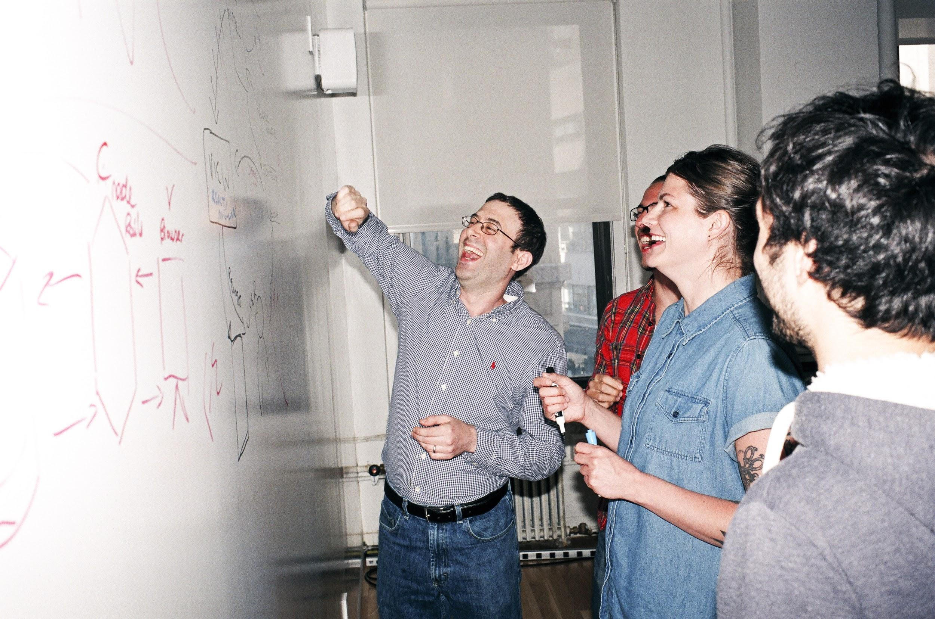

Welcome to General Assembly
WiFi GA Guest
Password yellowpencil
Notes:
[Leave this slide visible until presentation starts]

Slide 2
DATA SCIENCE
10 WEEK PART TIME COURSE
Week 3 - Logistic Regression

Slide 3
Course Plan
Paul & James review final project ideas

Slide 4
Git & GitHub – 1 Pager Guide!
Squash the GIT confusion from last class!
1-Pager follows through the steps clearly
Run through this once together ➔ CRYSTAL CLEAR

Slide 5
Git & GitHub – 1 Pager Guide!

Slide 6
AGENDA
Motivation
What is Logistic Regression?
Evaluating Logistic Regression
Lab4a - Logistic Regression using Titanic data
Lab4b - Jupyter Notebook Practice
Lab5 - Statistical Inference
Homework Review

Slide 7
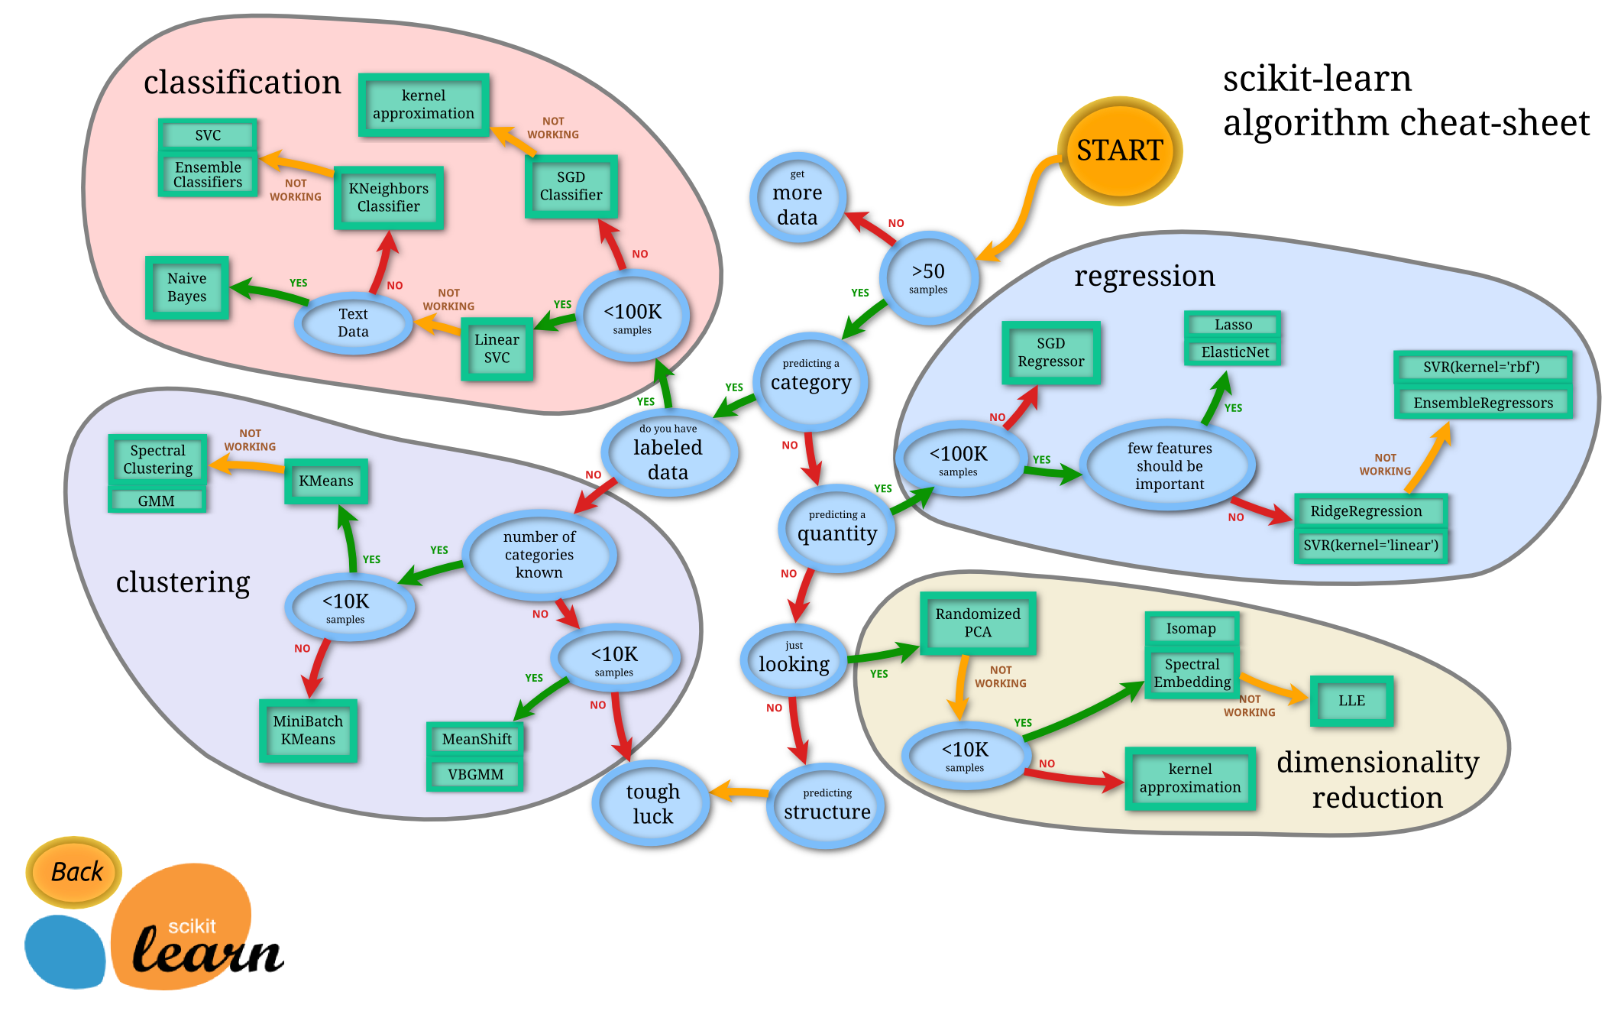

Slide 8
SUPERVISED LEARNING - REGRESSION & CLASSIFICATION
If the y variable is numeric then we have a regression problem - we are trying to predict a continuous number
If the y variable is a category (for example trying to predict a type of flower) the we have a classification problem - we are trying to classify what group that y belongs to.

Slide 9
WHAT IS LOGISTIC REGRESSION?
DATA SCIENCE PART TIME COURSE

Slide 10
LOGISTIC REGRESSION
We want to build a BINARY classifier that correctly identifies which class our target variable y belongs to given our input variable x.
Why not use the linear regression model?
y=Xβ+ϵ

Slide 11
LOGISTIC REGRESSION
Predicting
Regression is limited to (0,1) prediction could be > 1 or < 0 …
We want a classification method that can handle these cases and give us results we can easily interpret.

Slide 12
LOGISTIC REGRESSION
p(Y=1|X) = β₀ + β₁X.
This is a good starting point but we still have the problem of p(Y) being outside the 0,1 range.
We need to model p(Y=1|X) using a function that gives outputs between 0 and 1.
Basically we want something that looks like the following

Slide 13
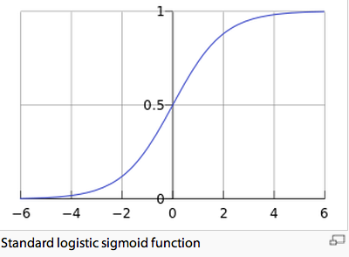
LOGISTIC REGRESSION

Slide 14
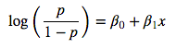
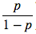
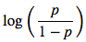
LOGISTIC REGRESSION
This is the logit function,
We can see that it this function is linear in X
is called the ‘odds’ and can be any value from 0 to ∞
is called the ‘log-odds’ or ‘logit’

Slide 15
EVALUATING LOGISTIC REGRESSION
DATA SCIENCE PART TIME COURSE

Slide 16
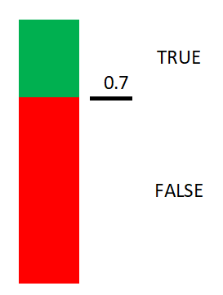
How to Classify Using Probability?
We transformed a discrete prediction problem into a continuous prediction problem. How do we go back and answer the original problem?
Q: How do we convert a probability to a prediction?
A: Specify a threshold for classification:
e.g. ‘True’ = p (y = 1 | X) > 0.7
‘False’ = p (y = 1 | X) ≤ 0.7
Notes:
pregnancy test example?

Slide 17

DEFINITIONS!!!
DO NOT PANIC!!!!

Slide 18
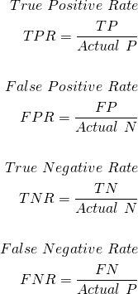
Accuracy of a Classification Model
Actual
“Precision”
Prediction
“Recall”
“True positive rate”
“True negative rate”

Slide 19
Accuracy of a Classification Model
accuracy score: accuracy_score = (TP + TN) / (TP + FP + TN + FN)
This is simply the fraction of correct predictions from the model.
So it is the number of correct predictions divided by the number of observations in our dataset.

Slide 20
Knowledge Check
true positive rate?
also called ...
__________?
__________?
true negative rate:
also called ...
__________?

Slide 21
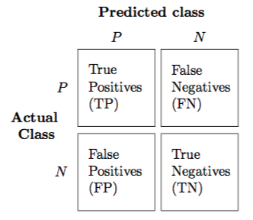
CONFUSION MATRIX
A confusion matrix shows us what the predicted class was against what the actual class was. The true class makes up the rows or the vertical axes and the predicted class makes up the columns or the horizontal axis.
Any entries in the diagonal of the matrix are those that are correctly classified.

Slide 22
RECEIVER OPERATING CHARACTERISTIC (ROC)
Receiver Operating Characteristic or ROC curve
Shows the performance of a binary classifier system as its discrimination threshold is varied
Plot the fraction of true positives out of the positives (TPR = true positive rate) vs. the fraction of false positives out of the negatives (FPR = false positive rate), at various threshold settings.

Slide 23
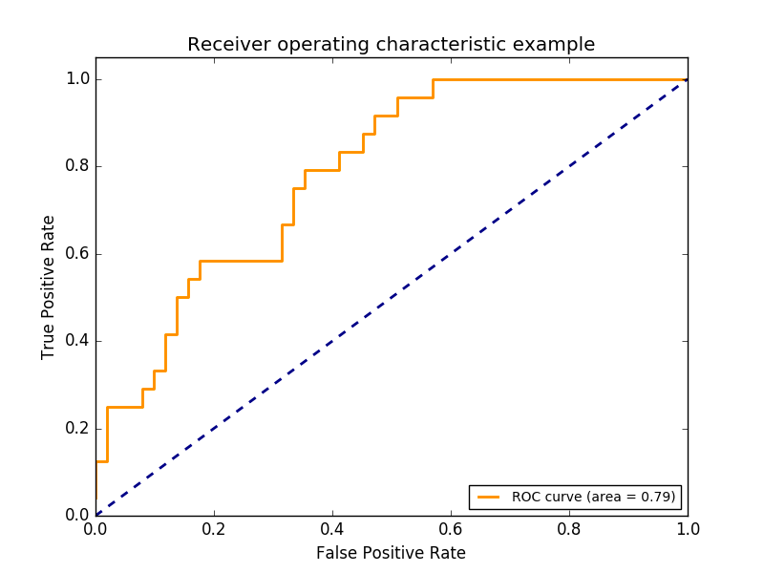
RECEIVER OPERATING CHARACTERISTIC (ROC)

Slide 24
RECEIVER OPERATING CHARACTERISTIC (ROC) - AREA UNDER THE CURVE(AUC)
By computing the Area Under the Curve of the ROC curve we get a single number summary of accuracy.
The closer that number is to 1 the more accurate our model is.

Slide 25
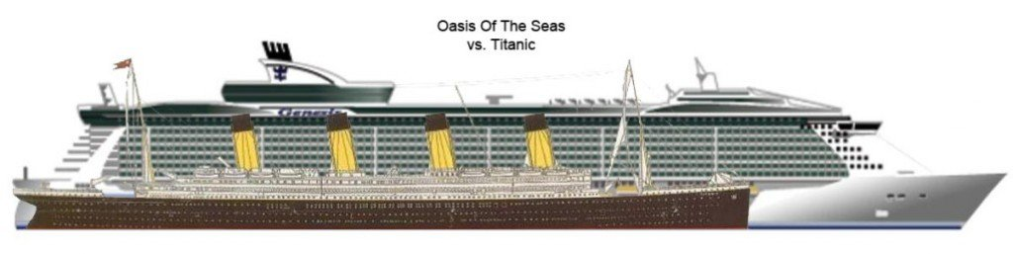
LOGISTIC REGRESSION - WALKTHROUGH NOTEBOOK
We will step through a notebook together and cover these concepts in a more tangible way.
Looking at the Titanic dataset

Slide 26
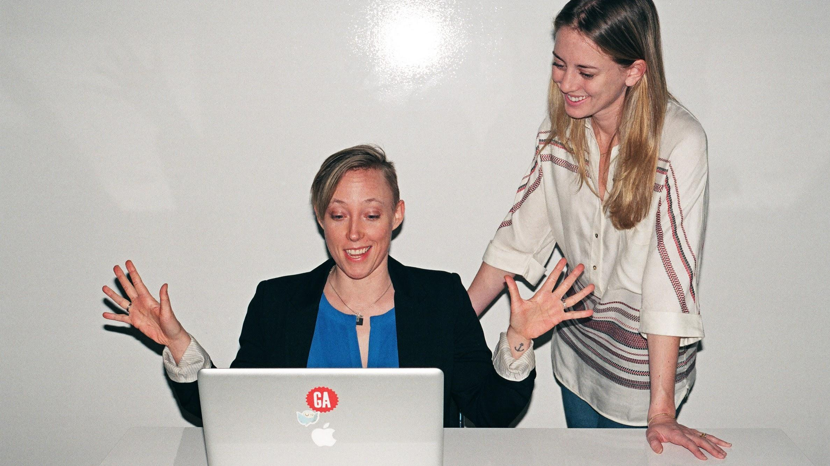
LAB: dat11syd/lessons/lesson-04/lab/
Lab4a_Logistic_Regression_Titanic

Slide 27
Dummy Variables
Used for representing categorical variables in a linear regression model
Sex: male = {0, 1}
Pclass: {1, 2, 3}
Age group: child = {0, 1}

Slide 28
Data Set: Titanic Survival
Variable | Definition | Key
Survived | survival | 0 = No, 1 = Yes
Pclass | ticket class | 1 = 1st, 2 = 2nd, 3 = 3rd
Name | name
Sex | sex
Age | age in years
Sibsp | # of siblings, spouses aboard
Parch | # of parents, children aboard
Ticket | ticket number
Fare | passenger fare
Cabin | cabin number
Embarked | port of embarkation
Data Dictionary: (‘titanic-dic.csv’)
Notebook:
‘Lab 4 - Logistic Regression.ipynb’

Slide 29
Logistic Regression Modelling
sklearn.linear_model.LogisticRegression(penalty=’l2’, dual=False, tol=0.0001, C=1.0, fit_intercept=True, intercept_scaling=1, class_weight=None, random_state=None, solver=’liblinear’, max_iter=100, multi_class=’ovr’, verbose=0, warm_start=False, n_jobs=1)
http://scikit-learn.org/stable/modules/generated/sklearn.linear_model.LogisticRegression.html
Method:
split the dataset into a training subset and a test subset
train the model on the training data
test the model on the test data
Issues with this approach?
Resolutions?

Slide 30
LAB: dat11syd/lessons/lesson-04/lab/
Lab4b_Jupyter_Practice

Slide 31
LAB
Hypothesis Testing

Slide 32
LAB: dat11syd/lessons/lesson-04/lab/
Lab5_Statistical_Inference
Probability Density Functions
The Normal Distribution
The t-Distribution
Student's t-Test

Slide 33
WEEK 2 Review
DISCUSSION TIME
Visualisation
Supervised vs Unsupervised Learning
Linear Regression

Slide 34
DISCUSSION TIME
Logistic Regression applied to loan applications (https://github.com/nborwankar/LearnDataScience)
Logistic Regression video (watch at 1.5x speed)
https://www.youtube.com/watch?v=-la3q9d7AKQ
Odds Ratio in Logistic Regression
http://www.ats.ucla.edu/stat/mult_pkg/faq/general/odds_ratio.htm
DATA SCIENCE - Week 3 Day 1

Slide 35
DISCUSSION TIME
Homework/Course Project
How’s Homework 1 going ?
How are the projects going?
DATA SCIENCE - Week 3 Day 1

Slide 36
PRE-READING
An Introduction to Statistical Learning
Chapter 5 - Resampling Methods
OR
Watch:
Cross validation https://www.youtube.com/watch?v=CmEqvD_ov2o
Bootstrapping https://www.youtube.com/watch?v=PmKOOGVRsmc
DATA SCIENCE - Week 3 Day 1

